Slide 1
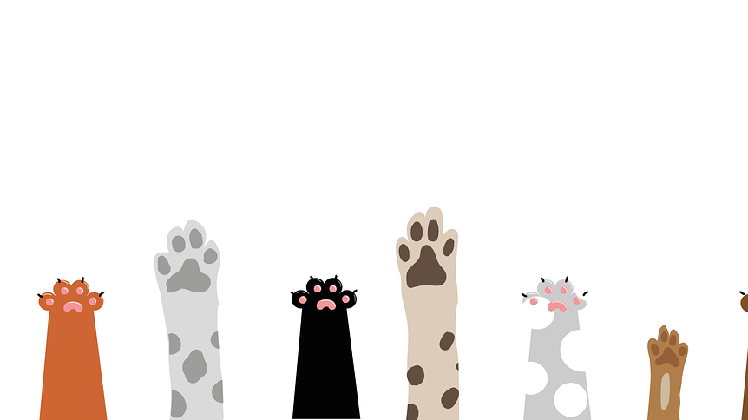

Overview of the Main Supervised Classification Models
Luis Miralles
Dog or cat?
Dog or cat?
Dog or cat?
Dog or cat?
Dog or cat?
Dog or cat?

Slide 2
Class outline
Linear regression
Logistic regression
K-Nearest Neighbour
Support Vector Machine
Naïve Bayes
Decision Trees, Random Forests, and Gradient Boosting
Neural Networks
Deep Neural Networks

Slide 3
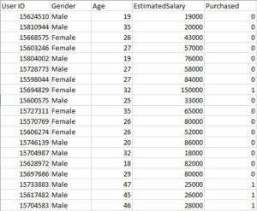
Dataset description
This dataset contains information on users from a company's database. It includes information on the user, Gender, Age, Estimated Salary, and Purchased.
We use this dataset to predict whether a user will purchase the company’s newly launched product.
https://prutor.ai/logistic-regression-using-python/
Examples and images taken from: https://www.javatpoint.com/machine-learning

Slide 4
Linear Regression
Step by step classification

Slide 5
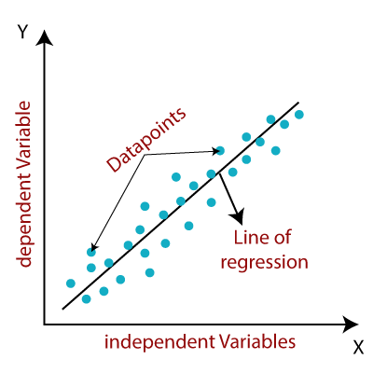
Linear regression
Regression
y= a₀+a₁x
Y= Dependent Variable (Target Variable)
X= Independent Variable (predictor Variable)
a₀= Intercept of the line (Gives an additional degree of freedom)
a₁ = Linear regression coefficient (scale factor to each input value)

Slide 6
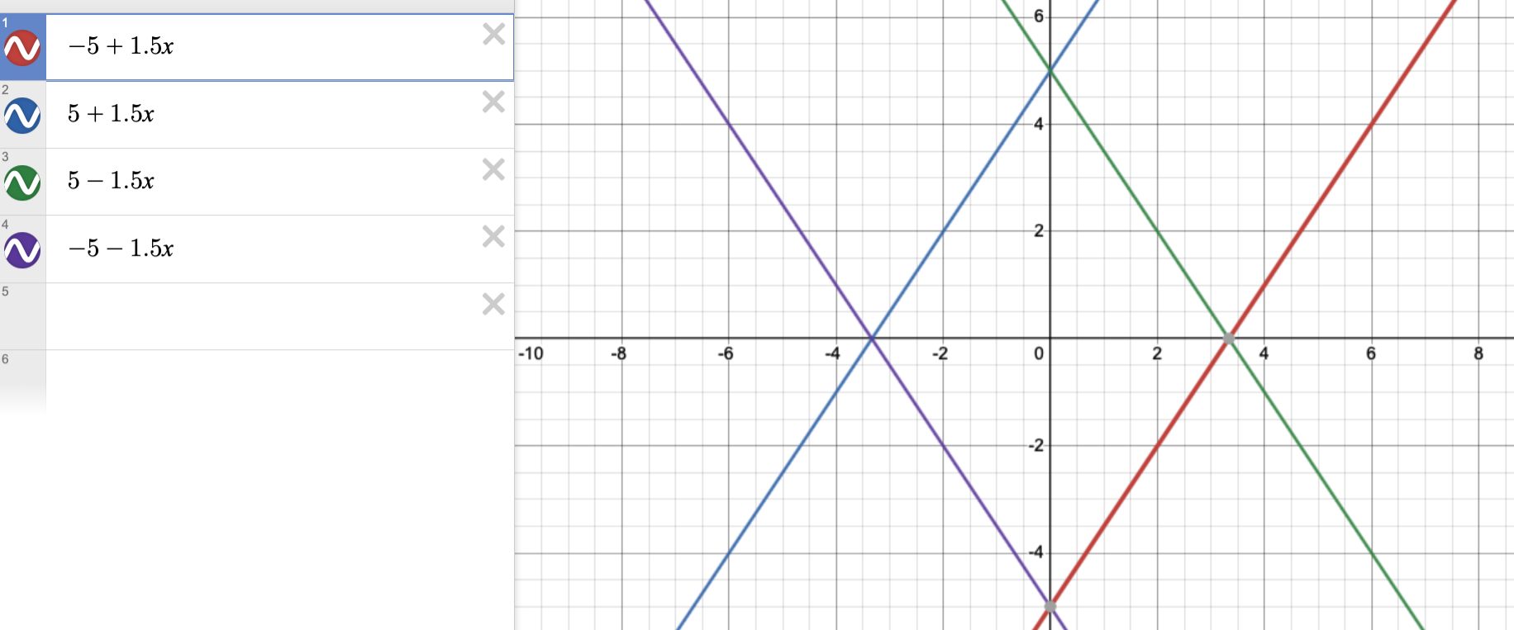
Linear regression
y= a₀+a₁x
https://www.desmos.com/calculator

Slide 7
Linear Regression
Y ∈ {0,1}
P₅
P₆
P₇
P₈
1
Yes
Diabetic?
0.5
0
No
P₁
P₂
P₃
P₄
Sugar level blood

Slide 8
Linear Regression
Y ∈ {0,1}
P₅
P₆
P₇
P₈
1
Yes
Diabetic?
0.5
Value of P4
0
No
P₁
P₂
P₃
P₄

Slide 9
Linear Regression
Y ∈ {0,1}
P₅
P₆
P₇
P₈
1
Yes
Diabetic?
0.5
If f(x) >= 0.5, then “y=1”
If f(x) <= 0.5, then “y=0”
Value of P4
0
No
P₁
P₂
P₃
P₄

Slide 10
Linear Regression
Y ∈ {0,1}
P₅
P₆
P₇
P₈
1
Yes
New
point
added
Diabetic?
0.5
If f(x) >= 0.5, then “y=1”
If f(x) <= 0.5, then “y=0”
Value of P4
0
No
P₁
P₂
P₃
P₄

Slide 11
Linear Regression
Y ∈ {0,1}
P₅
P₆
P₇
P₈
1
Yes
This point is now
misclassified
New
point
added
Diabetic?
0.5
If f(x) >= 0.5, then “y=1”
If f(x) <= 0.5, then “y=0”
Value of P4
The problem is that f(x) can be bigger or smaller than 0.
0
No
P₁
P₂
P₃
P₄

Slide 12
Logistic Regression
Step by step classification

Slide 13
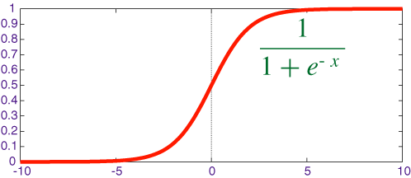
Sigmoid function
If f(x) >= 0.5, then “y=1”
If f(x) <= 0.5, then “y=0”

Slide 14
Logistic Regression
Classification
P₅
P₆
P₇
P₈
1
Yes
0.5
Y ∈ {0,1}
0
No
P₁
P₂
P₃
P₄

Slide 15
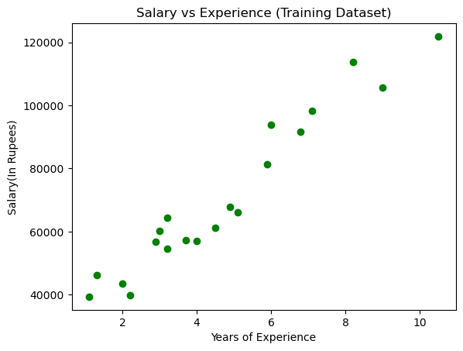
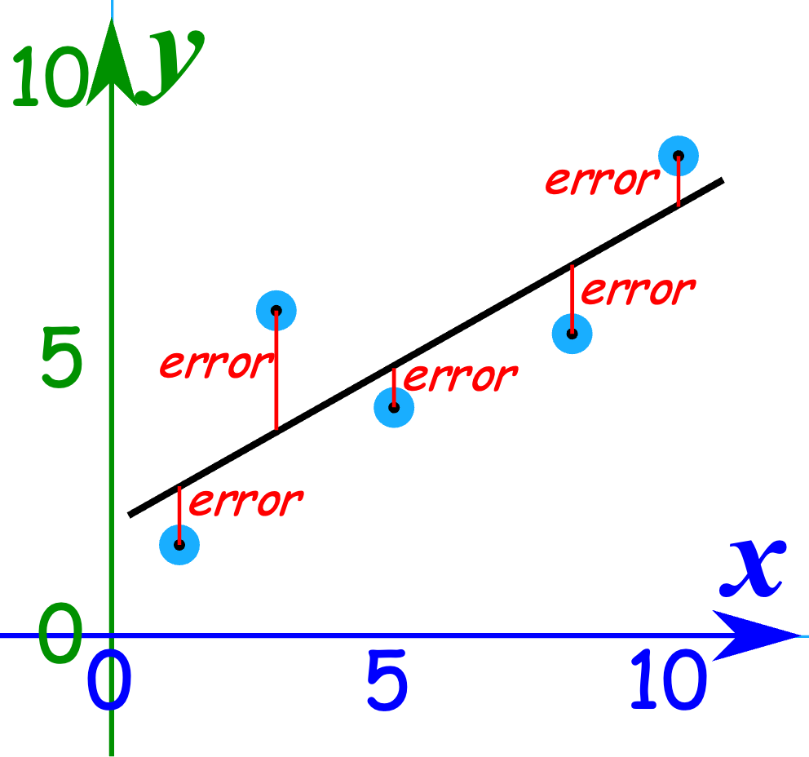
The least squares method calculates the coefficients of the regression lines to obtain the one that is closest, on average, to all the points.

Slide 16
K-Nearest Neighbour (KNN)
Classification
K-Nearest Neighbour is one of the simplest Machine Learning algorithms based on the Supervised Learning technique.
The K-NN algorithm assumes that the new case/data is similar to the available cases and assigns the latest case to the most similar category.

Slide 17
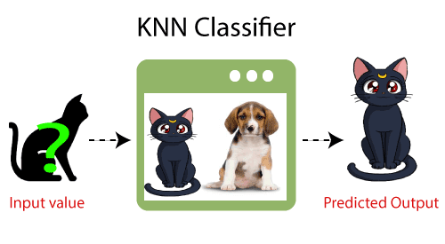
K-Nearest Neighbor(KNN)

Slide 18
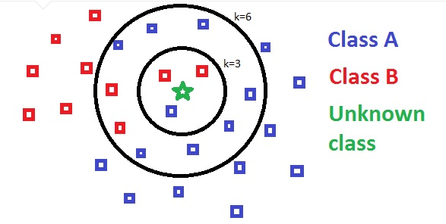
K-Nearest Neighbor(KNN)
https://towardsdatascience.com/knn-using-scikit-learn-c6bed765be75?gi=a3139f42dda6

Slide 19
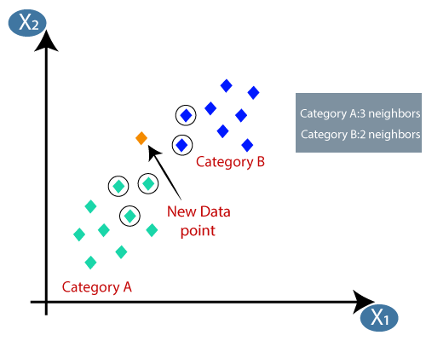
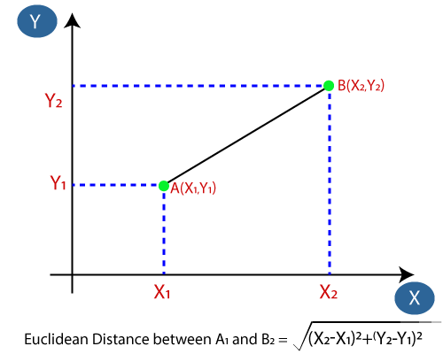
K-Nearest Neighbor(KNN)

Slide 20
Support Vector Machine
Classification
The SVM algorithm aims to create the best line or decision boundary to segregate n-dimensional space into classes and quickly place the new data point in the correct category. This best decision boundary is called a hyperplane.
SVM chooses the extreme points/vectors that help create the hyperplane. These extreme cases are called support vectors; hence, the algorithm is termed a Support Vector Machine.

Slide 21
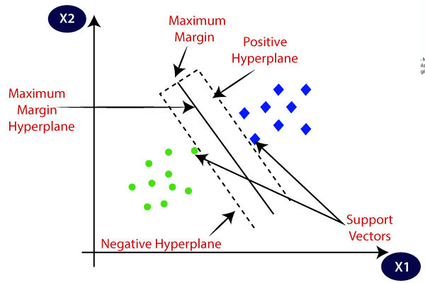
Support Vector Machine Algorithm

Slide 22
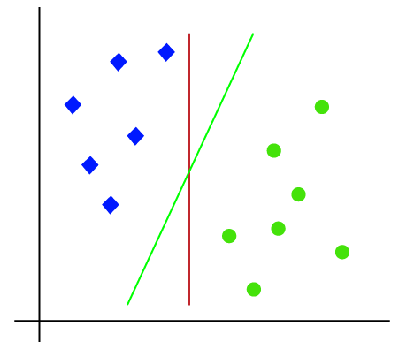
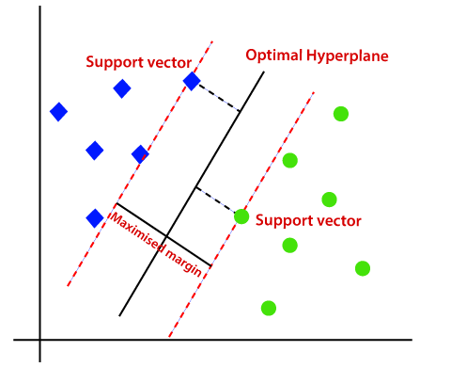
Support Vector Machine Algorithm

Slide 23
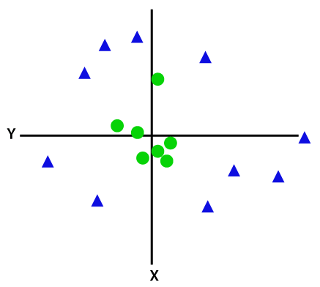
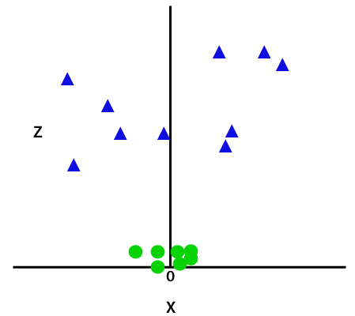
Support Vector Machine Algorithm
For non-linear data, we will add a third dimension, z. It can be calculated as:
z=x² +y²

Slide 24
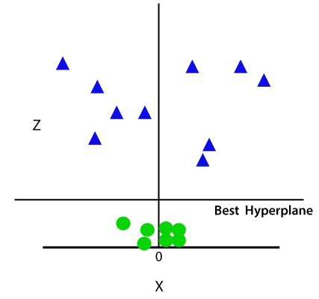
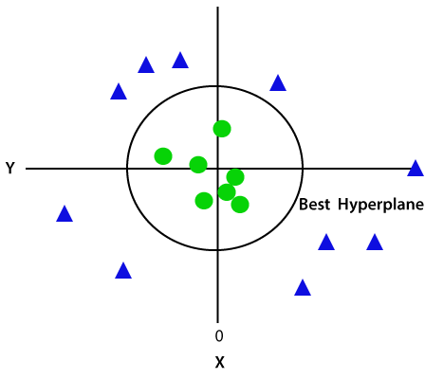
Support Vector Machine Algorithm

Slide 25
Decision Trees
Classification, regression
DT are used for both classification and regression.
They create a tree using the training set, which is used later to predict the outcome.
It performs well in multi-class predictions compared to other algorithms.
They are easily biased and easy to interpret and visualise.
Random forests and Gradient boosts use them to build their models.

Slide 26



Decision Trees
Shannon-Entropy
Entropy with respect a given predictor
Information gain:
Decrease in entropy after a dataset is split

Slide 27
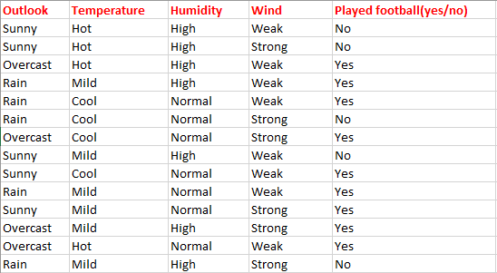
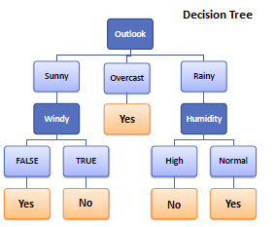
Decision tree structure

Slide 28
Random Forests vs Gradient Boosting
Aspect | Random Forests | Gradient Boosting
Algorithm Type | Ensemble of independent decision trees | Sequential ensemble of trees
Independence | Trees are built independently | Trees are built sequentially
Overfitting | Less prone to overfitting | Can be prone to overfitting
Predictive Performance | Robust, good baseline model | Can achieve high predictive performance
Speed | Faster to train (independent trees) | Slower to train (sequential trees)
Interpretability | Feature importances available, | Interpretation can be more complex

Slide 29
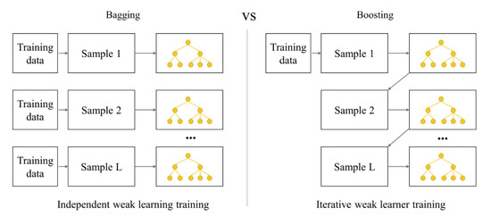
Random Forests vs Gradient Boosting
Classification, Regression

Slide 30
Naïve Bayes
Classification
Naïve Bayes is one of the fastest and easiest ML algorithms to predict a class of datasets.
It can be used for Binary as well as Multi-class Classifications.
It performs well in multi-class predictions compared to other algorithms.
It is the most popular choice for text classification problems.

Slide 31
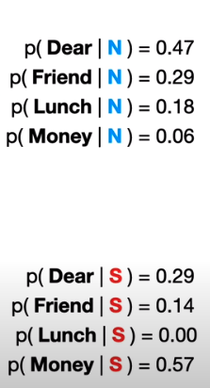


Naïve Bayes
P(N) = 8/(8+4)=0.67
How can we predict the
message “Dear Friend”?
P(S) = 4/(8+4)=0.33
8 are normal and
4 are spam.
https://www.youtube.com/watch?v=O2L2Uv9pdDA

Slide 32
Naïve Bayes
P(N) = 8/(8+4)=0.67
P(N | Dear friend) = 0.67 X 0.47 X 0.29 = 0.09
Dear Friend
It is predicted as
Normal message because
0.09 > 0.01
P(S) = 4/(8+4)=0.33
P(S | Dear friend) = 0.33 X 0.29 X 0.14 = 0.01
https://www.youtube.com/watch?v=O2L2Uv9pdDA

Slide 33
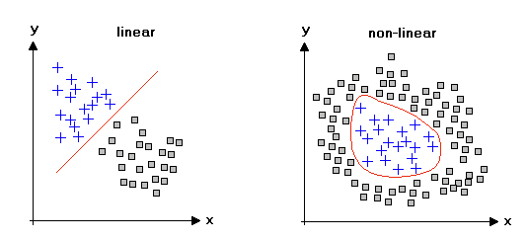
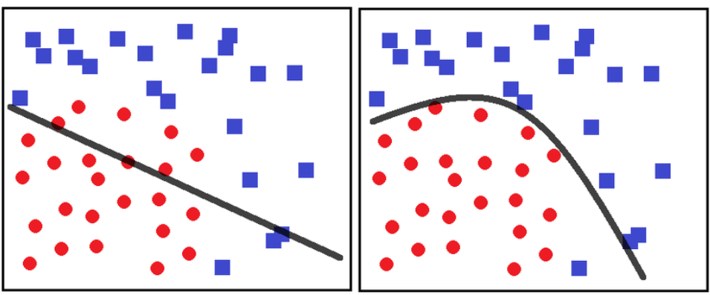
Neural Networks: Modelling non-linear data
If you have a linear activation function, the signal is amplified or dampened but not transformed. If you have a non-linear activation function, the signal is transformed, which helps detect complex patterns in the data.
https://www.picsellia.com/post/activation-functions-and-neural-networks
https://www.linkedin.com/pulse/significance-non-linearity-machine-learning-deep-ajit-jaokar-nakfe/

Slide 34
Sigmoid function
If f(x) >= 0.5, then “y=1”
If f(x) <= 0.5, then “y=0”

Slide 35
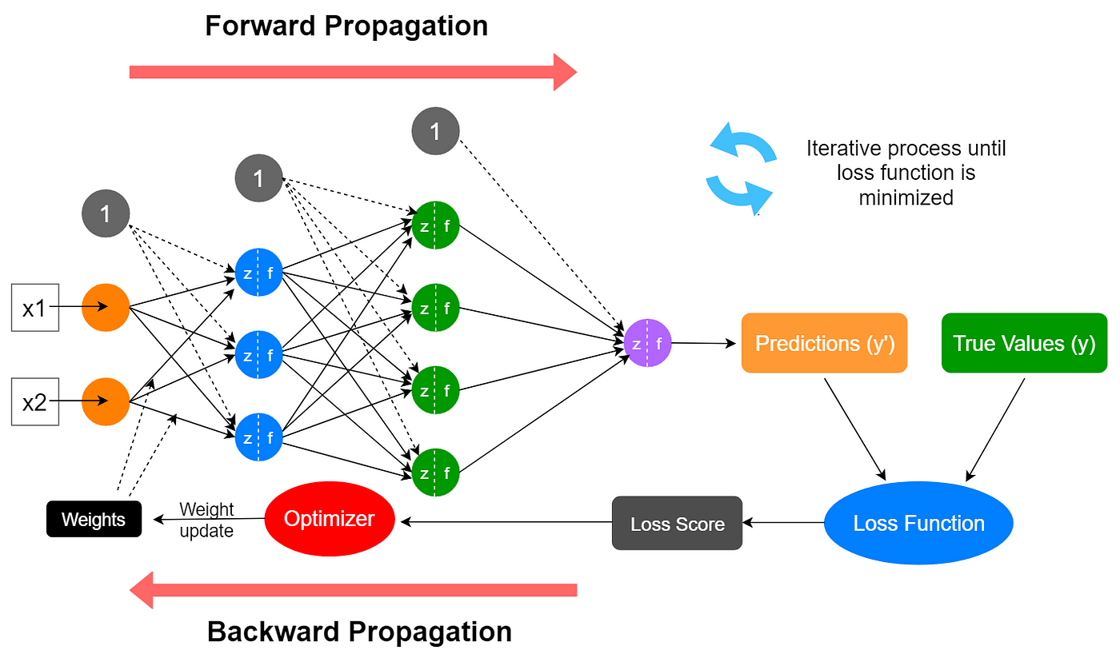
Neural Networks
Classification, Regression
https://medium.com/data-science-365/overview-of-a-neural-networks-learning-process-61690a502fa

Slide 36
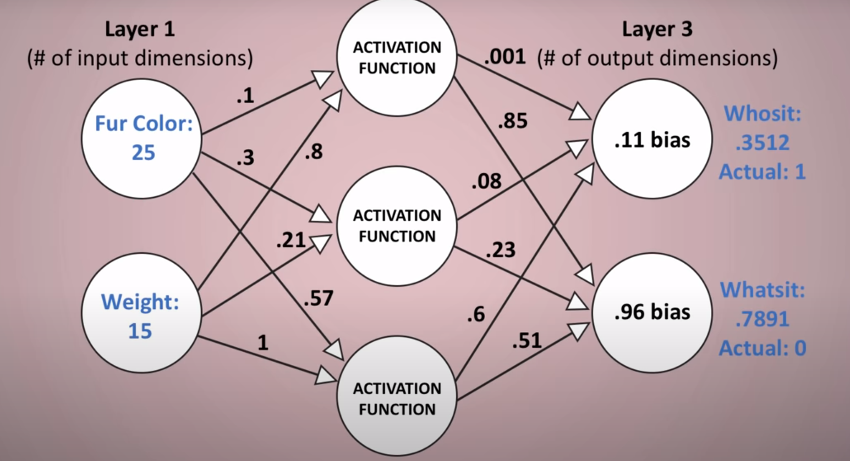
Example of Neural Network

Slide 37
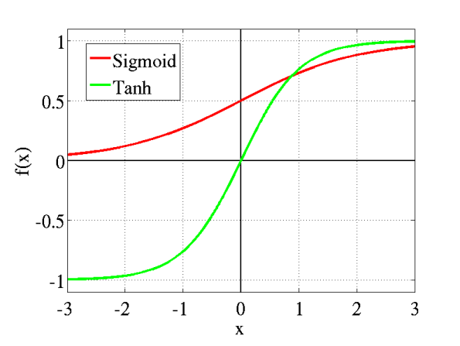
Neural Networks: Activation functions
An Activation Function decides whether a neuron should be activated or not.

Slide 38
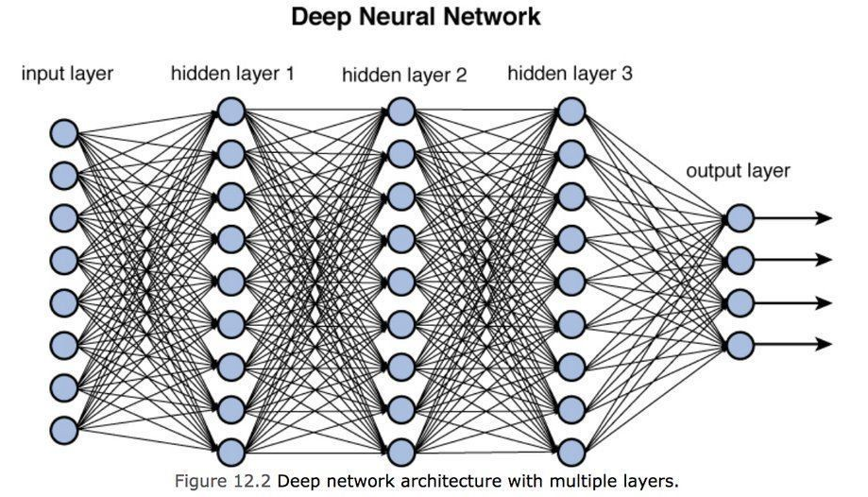
Deep Neural Networks
Classification, Regression
https://towardsdatascience.com/training-deep-neural-networks-9fdb1964b964

Slide 39
References
https://www.youtube.com/watch?v=OCwZyYH14uw
https://www.javatpoint.com/machine-learning
https://www.cs.cmu.edu/~mgormley/courses/10601b-f16/lectureSlides/lecture15-neural-nets.pptx

